Slide 1
MAC Layer Protocols for Wireless Networks

Slide 2
Interference / Collisions
Packets which suffered collisions should be re-sent.
Ideally, we would want all packets to be sent collision-free, only once…
a
b
a and b interfere and hear noise only
b
b
a
c
a
c
d
Interference on node b
(“Hidden terminal problem”)
Interference on node b

Slide 3
CSMA Protocol
Contention-based protocols
CSMA — Carrier Sense Multiple Access
Ethernet (CSMA/CD) is not enough for wireless (collision at receiver cannot detect at sender)
A
B
C
Hidden terminal: A is hidden from C’s CS

Slide 4
Hidden Terminal Problem
Data
Data
A
B
C
A and C want to send data to B
A senses medium idle and sends data
C senses medium idle and sends data
Collision occurs at B

Slide 5
Collision Avoidance w/ RTS/CTS
1.RTS
2.CTS
2.CTS
A
3.Data
B
C
A and C want to send to B
A sends RTS (Request To Send) to B
B sends CTS (Clear To Send) to A C “overhears” CTS from B
C waits for duration of A’s transmission

Slide 6
Overview of MAC Protocols
Contention-based protocols (contd.)
IEEE 802.11 Distributed Coordination Function (DCF)
Based on CSMA/CA

Slide 7
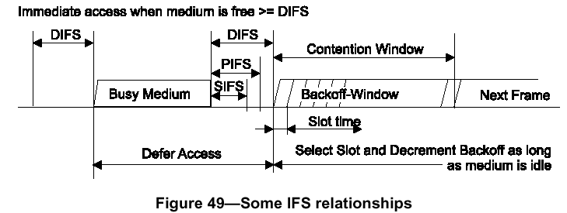
802.11 DCF (Distributed Coordinate Function)
Station listens before transmission
If medium is free for more than DIFS: transmits
Otherwise, uses exponential backoff mechanism

Slide 8
IEEE 802.11 DCF
Distributed coordinate function: ad hoc mode
In a network where a number of stations contend for the wireless medium, if multiple stations sense the channel busy and defer their access, they will also virtually simultaneously find that the channel is released and then try to seize the channel. As a result, collisions may occur.

Slide 9
IEEE 802.11 DCF
In order to avoid such collisions, DCF also specifies random backoff, which forces a station to defer its access to the channel for an extra period. The length of the backoff period is determined by the following equation:
B a c k o f f T i m e = r a n d o m ( ) × a S l o t T i m e

Slide 10
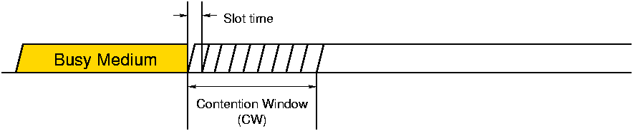
Random Backoff
Time
Pick a timeslot chosen uniformly in [0, CW]
Listen up to chosen slot
Transmit if nobody else started transmitting
Wait if somebody else started transmitting

Slide 11
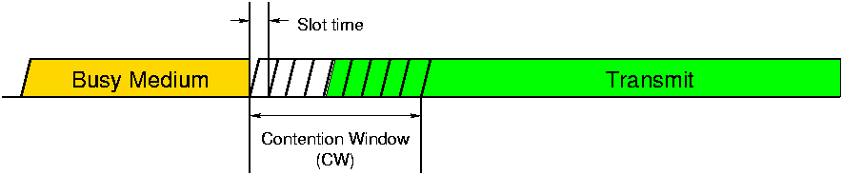
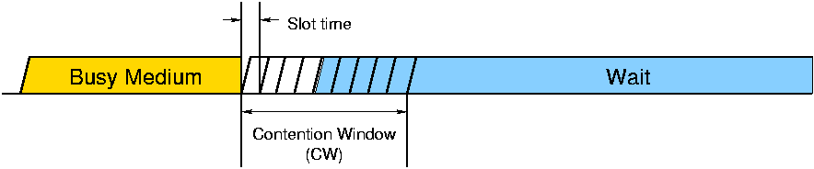
Example: A Successful Transmission
A and B happened to choose different slots
Node A chooses slot 4, hears nothing, transmits
Node B chooses slot 8, hears Node A,
Slot choice (slot #4)
Node A:
Slot choice (slot #8)
Node B:
Time
Success: exactly one node in first non-vacant slot

Slide 12
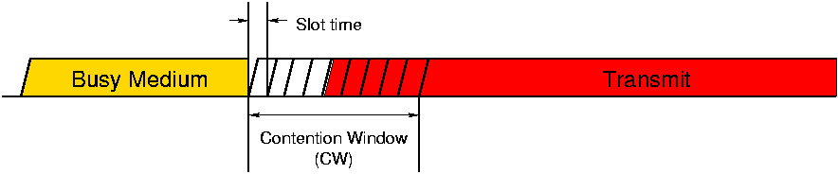
Example: A Collision
A and B happened to choose slot 4
Both listen and hear nothing
Both transmit simultaneously
Node A:
Slot choice (slot #4)
Time
Node B:
Slot choice (slot #4)
Collision: ≥ 2 nodes in first non-vacant slot

Slide 13
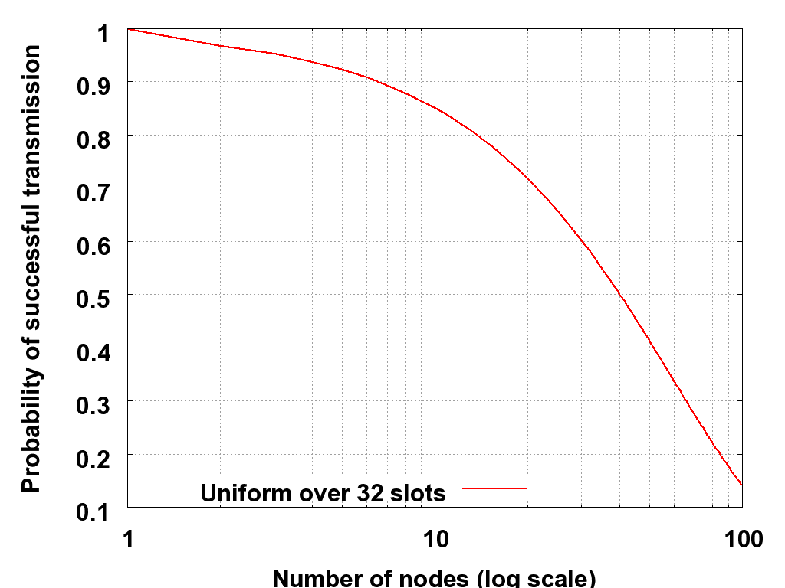
High Contention Causes Collisions in CSMA
Unacceptable collision rate above
~15 transmitting sensors
Uniform distribution “fills up,” quickly

